Slide 1

Celebrating integrity
Notes:
The ninth British-expedition attempt to scale the height of Everest, the world’s highest mountain, took place in May 1953. Led by John Hunt, the climbers were paired into teams, and Tom Bourdillon and his partner, Charles Evans, came to within 300 feet of the peak. Oxygen problems forced their return to camp, but by creating a trail and leaving behind equipment, they facilitated the successful ascent by Edmund Hillary and Tensing Norgay. For the millions of people celebrating the coronation of Queen Elizabeth II on June 2, 1953, this news added a frenzy of exhilaration to the already excited populace.
For several years this first ascent of Everest was labeled a “team effort,” with “we reached the top together” being the news release. A few years later, however, Tensing said that “only the truth is good enough for Everest,” and then indicated that Hillary had put his foot on the peak first. Such honesty speaks to the integrity of Tensing Norgay.

Slide 2

Transparency and trustworthiness
Notes:
Integrity—as strange as it may seem—is also an essential factor in the prescription for the vital and exuberant celebration of health. It’s a motivational ingredient that is very much at work in the implementation of health practices.
The distinction between integrity and simple honesty at times may be unclear. Integrity is a concordance in the life between theory and practice. It’s the transparency and trustworthiness that should characterize our every action. When there is a difference between what we say and what we do, we demonstrate a need for integrity.

Slide 3

“Honesty means…you don’t lie?”
Notes:
On the Yahoo Web site forum “Yahoo Answers,” questions were raised on the meaning of honesty and integrity and the difference between the two. Among the answers were these two:
“Honesty means that whatever you’ve done—good or bad—you speak the truth about it. In other words, you don’t lie.”
“Integrity means that you adhere to a moral conviction or code of honor that won’t allow you to do certain things that you feel would debase you.”
While not dictionary definitions, these Yahoo answers illustrate the role integrity plays in determining our actions. Honesty may lead to confession or admission of guilt, but it may not be sufficient to influence behavior. Integrity means there is a commitment to the principles espoused as being correct.

Slide 4
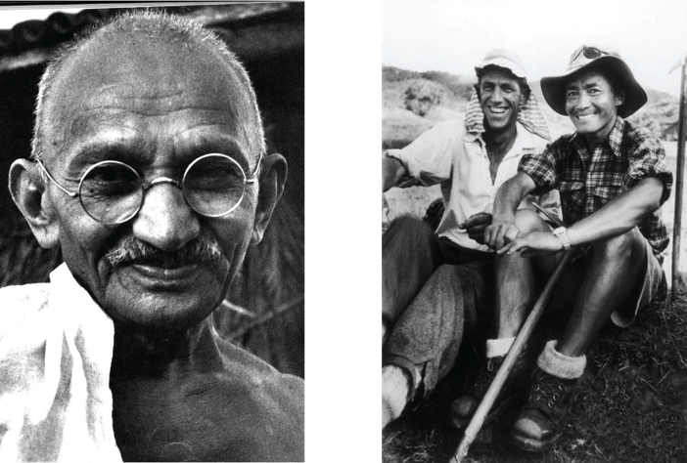

Hillary & Norgay
Notes:
While still a young South African lawyer, Mahatma Gandhi committed to the cause of justice and by example taught others the power and influence of integrity. George Ludwig recounts the following story:
“A mother once brought her child to him, asking him to tell the young boy not to eat sugar because it was not good for his diet or his developing teeth. Gandhi replied, ‘I cannot tell him that. But you may bring him back in a month.’
“The mother was angry as Gandhi moved on, brushing her aside. She had traveled some distance and had expected the mighty leader to support her parenting. She had little recourse, so she left for her home. One month later she returned, not knowing what to expect.

Slide 5
Hillary & Norgay
Notes:
“The great Gandhi took the small child’s hands into his own, knelt down before him, and tenderly communicated, ‘Do not eat sugar, my child. It is not good for you.’ Then he embraced him and returned the boy to his mother. The mother, grateful but perplexed, queried, ‘Why didn’t you say that a month ago?’
“‘Well,’ said Gandhi, ‘a month ago I was still eating sugar.’”¹
What power in example! What power in integrity!

Slide 6



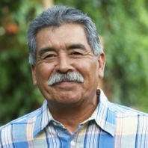


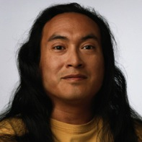
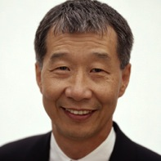
Integrity and public health
Notes:
Integrity can influence both an individual’s as well as a community’s health, because it calls for both loyalty and commitment to honest codes of belief and behavior.
In dealing with community health it’s essential to recognize the meaning of even subtle aspects of values, morality, ethics, and beliefs. In fact, the Public Health Leadership Society in 2002 published “Principles of the Ethical Practice of Public Health,” a document representing a consensus on a code of behavior for public health protagonists.² We will touch on only a few of the 12 principles the document addressed.
The first of these opinions deals with an individual’s health and states:
“Humans have a right to the resources necessary for health.”

Slide 7

Integrity and public health
Notes:
This is an affirmation of article 25 of the “United Nations’ Universal Declaration of Human Rights.” Such belief will influence many aspects of how we live and model health principles, and will also provide a basis for health education. It has a major impact on ethical behavior and will highlight the degree of integrity with which we function as a society regarding health.
Focusing on our community, the second belief and value states:
“Humans are inherently social and interdependent.”
As the document points out, “The rightful concern for the physical individuality of humans and one’s right to make decisions for oneself must be balanced against the fact that each person’s actions affect other people.”

Slide 8

Effects of immunization on public health
Notes:
Acceptance of this belief raises questions of integrity in how we relate to issues such as smoking and immunization and their effect on public health. Immunization programs, for example, may challenge our integrity as we consider our responsibility to the group when it comes to accepting or refusing immunization. We should keep in mind factors such as recent outbreaks of measles and their resultant morbidity and mortality, which have been traced to pockets of religious adherents who have declined immunization for their members and children.
This belief also will pose questions about the regulation of the availability of drugs that include prescription medications, alcohol, and substances often used in a so-called “recreational” fashion.

Slide 9

It’s a matter of integrity to balance personal biases and desires against community needs
Notes:
Integrity leads to absolute transparency, open accountability, and is the measure of our reliability. This, in turn, is a very important factor in the area of trust, which undergirds the use and effectiveness of health-care institutions, physicians, and allied health professionals.
Society’s 12 principles include the need for collaboration, an important ingredient in effective support of community health. It becomes a matter of integrity to balance personal biases and desires against community needs. Because “people are dependent upon their physical environment,” as stated in the “Principles” document, we have a duty to preserve and sustain the environment. Integrity demands this of us.

Slide 10

Ensure that all have a voice
Notes:
Recognizing the value of each individual, we will ensure that all have a voice and are heard in public discourse. Such action may seem to be common courtesy, but sometimes in matters of health, our personal convictions are so keenly felt that we are intolerant of another’s opinion and belief. If we claim to believe in the individual’s value, we are called by integrity to give opportunity and ear to others’ opinions. Integrity demands tolerance of people, even if we disagree with their opinions.
Another value of the “Principles of the Ethical Practice of Public Health” is “Identify and promote the fundamental requirements for health in a community.”
Often we substitute individual preferences for community needs, emphasizing the peripheral, borderline, unimportant, or trivial while areas of major importance are ignored. Typical of such personal bias would be an emphasis on avoiding soy products, dairy, certain oils, etc., in situations of famine, drought, poverty, or inequitable availability of a variety of foodstuffs. Integrity will require of us a balance in teaching, practice, and advocacy of certain health practices.

Slide 11

Integrity and personal health
Notes:
Integrity has personal as well as public health ramifications. It would teach us to recognize our common vulnerability and inherent weaknesses, but also our intrinsic worth and rightful equality as humans with inalienable rights. Such insight influences our belief in our commonality, our kinship in the human family, and our value to society in general. A great deal of mental ill health could be avoided if we possessed sufficient integrity that we would not impose our will on others, nor allow ourselves to be depreciated in our own eyes by the opinions of others.

Slide 12

Act on principles, not opinions
Notes:
To those whose actions are based on principle, integrity brings motivational insight. Humans are extremely vulnerable to distortions of fact, especially when it comes to personal behaviors.

Slide 13
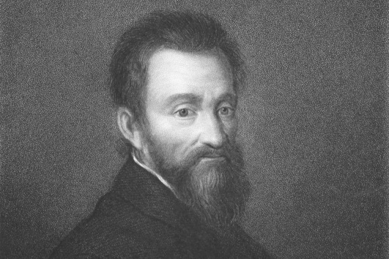
Michelangelo … “the world’s frivolities have robbed me”…
Notes:
This is an ancient problem. We are distractible. Michelangelo, perhaps the world’s most renowned of artists, wrote, “The world’s frivolities have robbed me of the time that I was given for reflecting upon God.” Integrity focuses our minds on truth, meaningfulness, value, and reality. When we address issues of health in this way, we’ll find that we’re dishonest most often with ourselves. The trite, frivolous, faddish, exotic, improbable, and sheer idiotic cease to captivate if we are truly honest. Integrity helps us to examine the evidence and recognize our own biases. It demands of us high standards and requires us to base our beliefs upon evidence, not fancy. In essence, integrity denies us hypocrisy.

Slide 14

They ignored the dangers
Notes:
Have you ever wondered how many addicts started down the road to ruin because they ignored the dangers of which they were well aware? Possessing integrity has protected thousands who have declined an offer of drugs, even though fascinated by the potential pleasure.
How many smokers ignored known facts in an effort to “fit in” or appear sophisticated? It’s far different to become an addict through ignorance than by deliberately ignoring the truth.
When we know that 7 percent of persons taking their first alcoholic drink will become alcoholics, and some 15 percent will have alcohol-related problems such as physical or sexual abuse or be harmed in an accident,³ shouldn’t we question our integrity if we serve such beverages?

Slide 15

Integrity can help us avoid problems
Notes:
Perhaps the most dangerous area regarding integrity is sexual behavior. The media trivializes marital infidelity and encourages sexual irresponsibility in the face of staggering numbers of single-parent children, insecurity, and emotional distress; this raises a question of corporate integrity.

Slide 16

HIV/AIDS has raised questions of corporate integrity
Notes:
On June 6, 1981, the U.S. Centers for Disease Control (CDC) published the first report of a new syndrome. The report described five young men who had an acquired immune-deficiency syndrome labeled AIDS, for short. Since then, millions upon millions have died, and millions more live with the virus. In Africa, the disease has orphaned more than 15 million children.
HIV/AIDS has raised dozens of questions of corporate integrity regarding such groups as the medical practitioners who declined to treat such patients, the pharmaceutical industry that held patients to excessive ransom, the governments that denied the existence of the disease, and the agencies that controlled blood products and moved so slowly that hundreds became infected.
The disease also challenged individual integrity: persons who willfully infected others, partners who denied the other the protection of a condom, and clerics who interfered without sufficient knowledge of the marital interactions of their parishioners. Then seldom addressed is the lack of integrity in promiscuous behavior by single and married individuals.

Slide 17

Integrity is the foundation
Notes:
Integrity impacts many aspects of living. We tend to compartmentalize our behaviors into work, church, social, and intellectual slots, resulting in glaring inconsistencies of integrity when we fail to integrate them. Integrity is the foundation for good mental health, trustworthy interpersonal relationships, and responsible and accountable behavior.

Slide 18

Mercy and forgiveness
Notes:
At one time or another everyone has failed to meet the standard of full integrity. Possibly, we have failed so miserably that someone has suffered. We may bear a burden of guilt and remorse.
Forgiveness is not easy for individuals to extend to others, but Jesus Christ described a forgiving God. He lived and died to exemplify grace. All the religions of the world teach that forgiveness is attainable. Some require penance; Jesus Christ requires only contrition.
By the gift of grace God extends mercy and forgiveness. Even here, integrity is essential. We have to be honest enough to admit wrongdoing; it is by such confession that grace permits peace and rest to be attained. If we are to celebrate the completeness of whole-person health, integrity is essential.

Slide 19

LIFE APPLICATION QUESTIONS
Notes:
LIFE APPLICATION QUESTIONS

Slide 20

Do I consider myself to be an honest person?
Notes:
Do I consider myself to be an honest person?

Slide 21
What moral values have I adopted that prevent me from doing anything that would conflict with that code of honor?
Notes:
What moral values have I adopted that prevent me from doing anything that would conflict with that code of honor?

Slide 22
What sources have formed that set of values?
Notes:
What sources have formed that set of values?

Slide 23

When considering my own personal health, do I also take into account the needs of the community and how my choices could affect others?
Notes:
When considering my own personal health, do I also take into account the needs of the community and how my choices could affect others?

Slide 24

What choices have I made with respect to personal hygiene, such as hand washing and staying away from contact with others when ill, have positively affected my community?
Notes:
What choices have I made with respect to personal hygiene, such as hand washing and staying away from contact with others when ill, have positively affected my community?

Slide 25

What practices for my own pleasure am I ashamed of because of the negative effects they may have on someone else?
Notes:
What practices for my own pleasure am I ashamed of because of the negative effects they may have on someone else?

Slide 26

A local church health ministries leader regularly presents lectures to the church members in which she advocates a total vegetarian diet.
Notes:
A local church health ministries leader regularly presents lectures to the church members in which she advocates a total vegetarian diet.

Slide 27
She also favors an organic diet, although she is aware that many of the members cannot afford the higher prices for organic foods.
Notes:
She also favors an organic diet, although she is aware that many of the members cannot afford the higher prices for organic foods.

Slide 28

Sometimes, however, she invites others to go with her to an ice cream parlor where she enjoys ice cream as a “special treat.”
Notes:
Sometimes, however, she invites others to go with her to an ice cream parlor where she enjoys ice cream as a “special treat.”

Slide 29
What lifestyle practices do I have that may conflict with what I “preach?” Am I truly “walking the talk?”
Notes:
What lifestyle practices do I have that may conflict with what I “preach”? Am I truly “walking the talk”?

Slide 30

What can I do to ensure that others trust what I say to them is in their best interest and not just my way of pushing my own personal beliefs?
Notes:
What can I do to ensure that others trust what I say to them is in their best interest and not just my way of pushing my own personal beliefs?

Slide 31

Am I promoting any health practices, dietary principles, etc., that would be unsuitable for a given situation in which I am not involved?
Notes:
Am I promoting any health practices, dietary principles, etc., that would be unsuitable for a given situation in which I am not involved?

Slide 32

Do I grant others the ability to hold their own opinions, even when I am sure I am right?
Notes:
Do I grant others the ability to hold their own opinions, even when I am sure I am right?

Slide 33

What personal choices fly in the face of evidence but are comfortable or desirable just because they are what I want to do?
Notes:
What personal choices fly in the face of evidence but are comfortable or desirable just because they are what I want to do?

Slide 34

What evidence presented in this book have I disregarded because it would be difficult or unpleasant to have to fit certain practices into my lifestyle?
Notes:
What evidence presented in this book have I disregarded because it would be difficult or unpleasant to have to fit certain practices into my lifestyle?

Slide 35

Have I violated my code of honor?
Do I admit my wrongdoing?
Notes:
Have I violated my code of honor?
Do I admit my wrongdoing?

Slide 36

What do I do with the guilt I feel because I have not lived up to my values?
Notes:
What do I do with the guilt I feel because I have not lived up to my values?

Slide 37
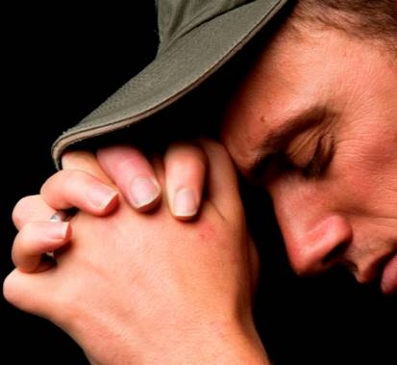
Do I punish myself by dwelling on my guilt or fall into a cycle of repeating the behavior again and again?
Or can I accept the mercy and forgiveness that Jesus freely offers?
Notes:
Do I punish myself by dwelling on my guilt or fall into a cycle of repeating the behavior again and again? Or can I accept the mercy and forgiveness that Jesus freely offers?

